Slide 1
Sprint Review 4 (Discussion)
By Malcolm Howard & Michael Hullett

Slide 2
Research Question
Our presentation consists of us comparing and contrasting NBA 2K and NBA Live. These two titles come from the two biggest video game franchises for the sport of basketball. These two franchises have been battling for the top spot as the number one basketball game since as early as 1999.
Which is the better game for your style of play?

Slide 3
NBA 2k
NBA 2K is a series of basketball sports simulation video games developed and released annually since 1999. The premise of each game in the series is to emulate the sport of basketball, more specifically, the National Basketball Association. The series was originally published by Sega Sports, and is now published by 2K Sports. All of the games in the franchise have been developed by Visual Concepts. The series consists of eighteen main installments and several spinoff-style titles. It has seen releases on eighteen different platforms. The NBA 2K series has also been used in eSports. Their primary rival was NBA Live by EA Sports until the series was put into a hiatus after the release of NBA Live 19 in 2018.

Slide 4
NBA Live
NBA Live is a series of basketball video games published by EA Sports. The series, which has had releases annually from 1994 to 2009, 2013 to 2015, and 2017–2018, is the successor to EA's previous NBA Playoffs and NBA Showdown series.
Beginning in the late 2010’s, NBA Live sales had dropped off compared to their competitors, NBA 2K. Even with WNBA teams being added into NBA Live 18 for the first time in the series, sales continued to decline, with NBA Live 19 being the final confirmed release, and eventually leading to the cancellation of NBA Live 20 and 21. As of 2021, there has not been any official announcements about a new game being developed in the series.

Slide 5
Similarities
As the years have gone by both of these franchises have grown exponentially in all categories, improving their statistics in graphics, gameplay, animation, and realism. They also have the same kind of concepts when it comes to their gameplay, gamemodes, and player ratings/statistics. These two franchises have always released their games around the same time in september which adds to the competitive spirit between the two.

Slide 6
Differences
Sales and popularity are the main two differentiating factors between these two franchises.
2K
Has a higher variety of gamemodes (proam)
Better quality franchise modes
Better single play experience
Live
Better Halftime entertainment
Higher rated music soundtrack
More realistic simulations

Slide 7
Game modes
2K
Live
Proam
MyCareer
Blacktop
PlayNow
MyTeam
MyGym
Also numerous amounts of online limited time modes in the multiplayer “Park”
Ultimate Team
Franchise
Ranked Head to Head
Career Mode (The one & The street)
Court Battles

Slide 8
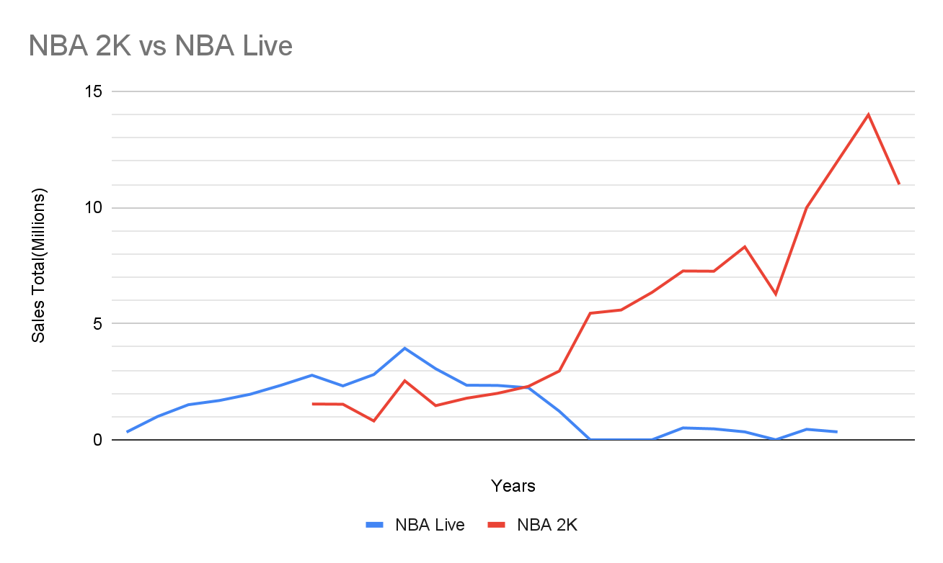

Slide 9
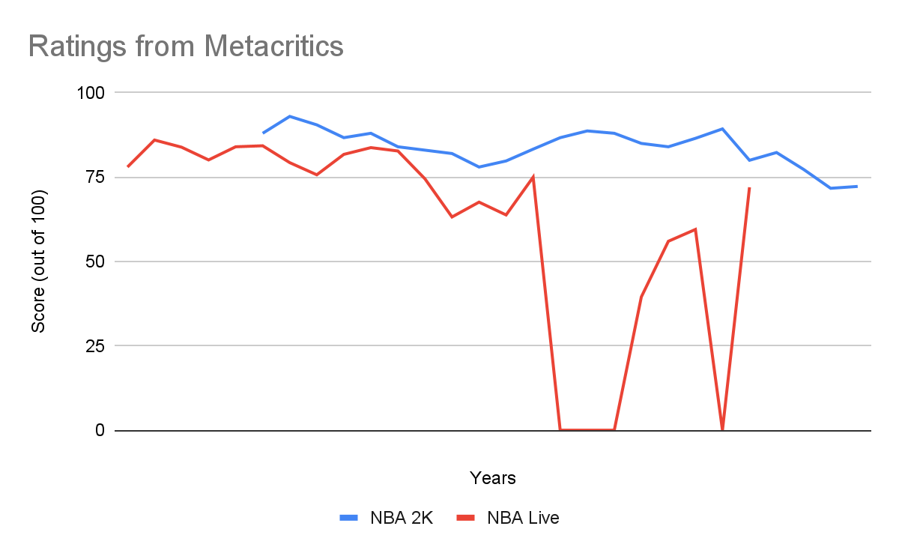

Slide 10
Customer comments
2K
Live
Awesome NBA game. First time in many years you can play online without any input lag. And basketball game now is much more similar to real basketball game.
The new NBA from 2K Games will probably make you happy. More realistic graphics go hand in hand with great entertainment. I appreciate the fact that there's no shortage of new gameplay elements, and time will tell what gamers will love the most.
I feel like the still need some tweaking but the gameplay feels realistic in some ways. I liked that the game has the NBA combine; the game just needs to add more things in play calling and better graphics but overall I liked a lot this game.
Fresh approach to the game of basketball. Great video game, much better than past years' versions.If you're tired of trend toward microtransactions, give this a try and you be surprised just how good it is (with every expectation of getting better).

Slide 11
Discussion
From the data we collected, NBA live is the game for you if you are more into an enjoyable simulation game and NBA 2K is the game for you if you are more into a competitive atmosphere. We can also see that NBA live was the game to beat coming in because it was the only basketball creator out, but 2K eventually ran them out of business and now 2K just give half work.

Slide 12
Limitations
All the data we needed to complete this topic was scarce like the sales of the earlier versions of the game so we had to work with what we could. Also, Nba live had some years missing due to being lack of competition. The last limitation was being able to implement R into our project.

Slide 13
Then and Now
Malcolm
Going into this project, I expected the setup with R and everything to be simple as the first lessons were real easy. As the course went along the more you had to do to get a code to run and it had to be precise for you to graph some data. The data was a surprise to me because I did not believe NBA Live competed with 2K at a high level at a point of time. I feel like if NBA Live was more focused on basketball games instead of the variety of games it have, it could still compete with 2k.
Michael
Starting this project I thought that it would be much simpler than it actually was. I thought we could search for some player ratings from each game and compare them but upon doing so I found it to be extremely difficult and time consuming. Now looking back at the project I wish we had been more specific and put more thought into what exactly we wanted to do with basketball in general. The NBA Live and NBA 2k competition was too lopsided to do an actually fair comparison.

Slide 14
References
Mazique, Brian. “'NBA 2K19' vs. 'NBA Live 19': Which Is the Better Basketball Game?” Forbes, Forbes Magazine, 19 Sept. 2018
2K. “2K22 Features Preview.” NBA 2K22, Take-Two Interactive Software, Inc, Aug. 2021
EA. “NBA Live 19.” NBA Live 19 , EA Sports, Aug. 2018
Websites we used (no articles)
https://www.metacritic.com/
https://www.vgchartz.com/game/226152/nba-2k/

